Slide 1


micro:bit entry video tutorial
Lesson 17
micro:bit creative lesson 17 “fruit picking”
YahBoom micro:bit creative tutorial

Slide 2
micro:bit entry video tutorial
Content
Part1
Part 2
Part3
Part 4
Part 5
Learning goals
Preparation
Handmade
Search for blocks
Combine blocks
YahBoom micro:bit module tutorial

Slide 3
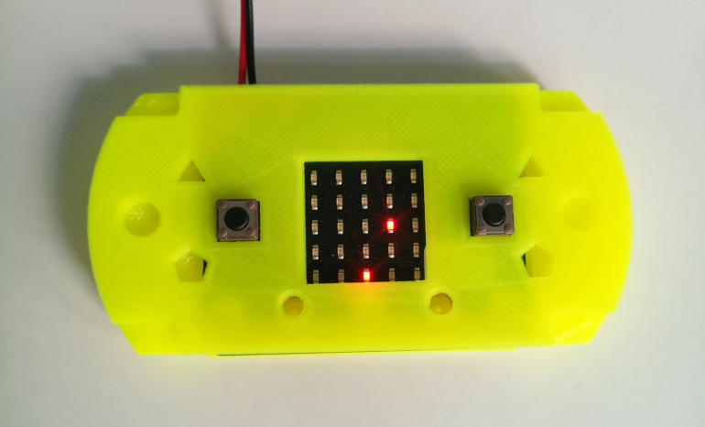
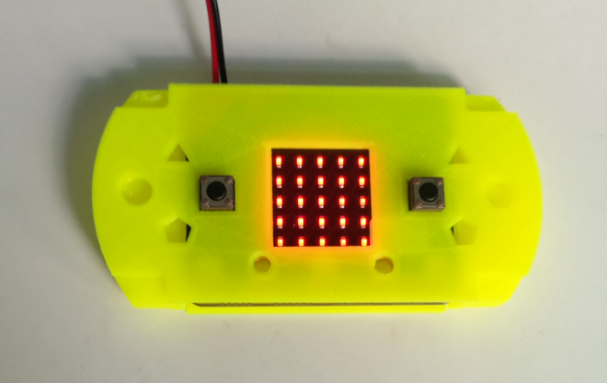
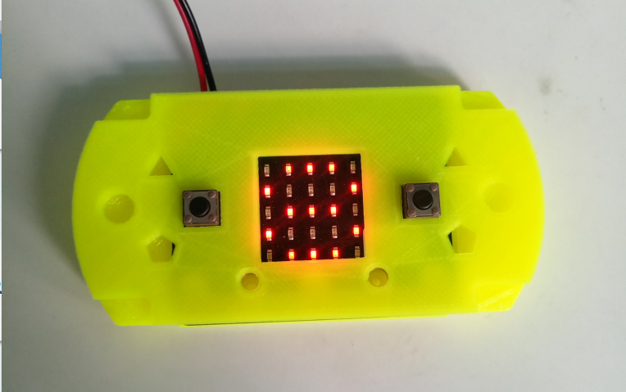
micro:bit entry video tutorial
Part 1
Learning goals
After you download the program, there will be a flickering picture on the micro:bit dot matrix, which means that the game will start. Then there will be a LED light falling down randomly (like a fruit falling down). There is a LED lamp on the bottom row (like a basket). We want to catch the fruit fallen on it. Press the A button, move it to the left, press the B button, and move to the right side. When the two touch together, it means that the basket receives the fruit and gets a point. You can play with your little buddies and see who gets more.
YahBoom micro:bit creative tutorial

Slide 4
micro:bit entry video tutorial
Part 2
Hardware:
● 1 X Micro: bit Board
● 1 X Micro USB Cable
● 1 X Consoles shell
● 1 X PC
Preparation
Then the micro:bit is connected to the computer through USB, and the computer will pop up a U disk and click the URL in the U disk to enter the programming interface.
YahBoom micro:bit video tutorial

Slide 5
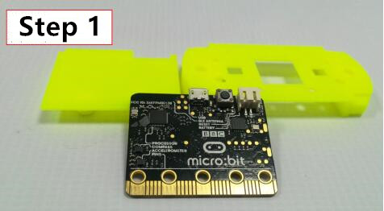
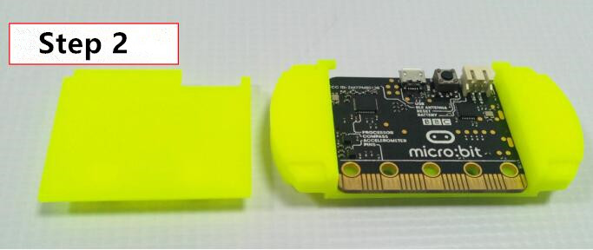
micro:bit entry video tutorial
Part 3
handmade
YahBoom micro:bit creative tutorial

Slide 6
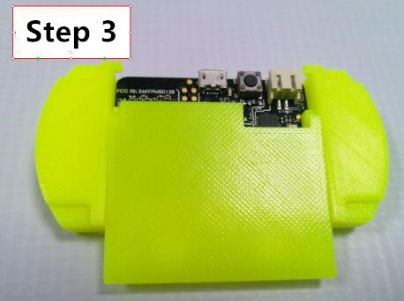
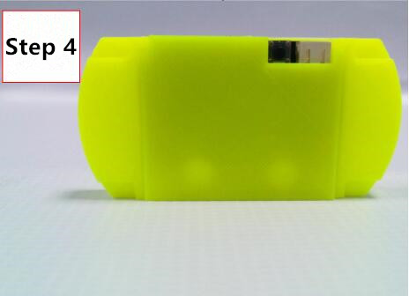
micro:bit entry video tutorial
Part 3
handmade
YahBoom micro:bit creative tutorial

Slide 7
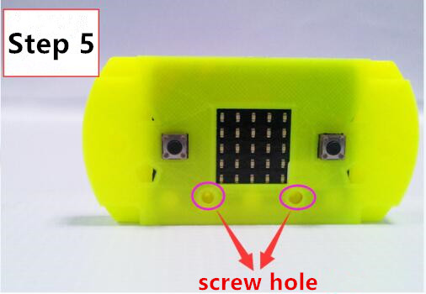
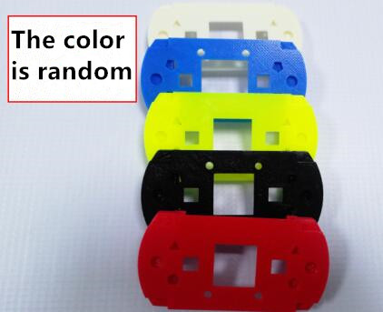
micro:bit entry video tutorial
Part 3
handmade
Remind you that we must pay attention to safety when assembling.Finally, install the two screws under the dot matrix. If the lid behind the game shell is not stable, please help daddy and Mommy. Remember to say thank you to mom and dad after you finished it.
YahBoom micro:bit creative tutorial

Slide 8
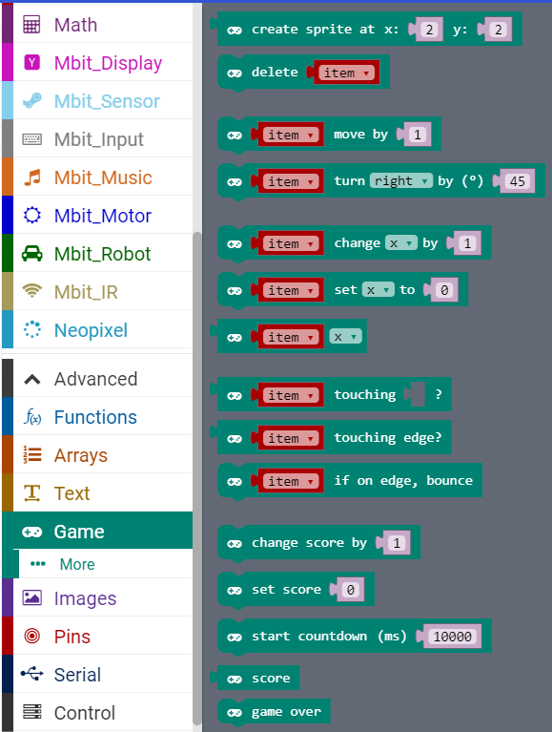
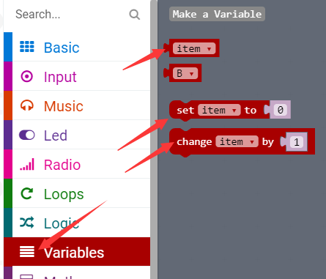
micro:bit entry video tutorial
Part 3
Search for blocks
YahBoom micro:bit creative tutorial

Slide 9
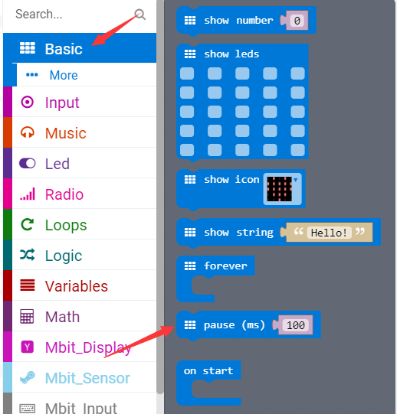
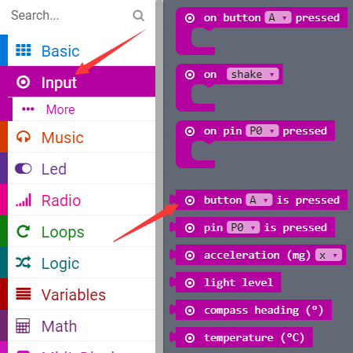
micro:bit entry video tutorial
Part 4
Search for blocks
YahBoom micro:bit creative tutorial

Slide 10
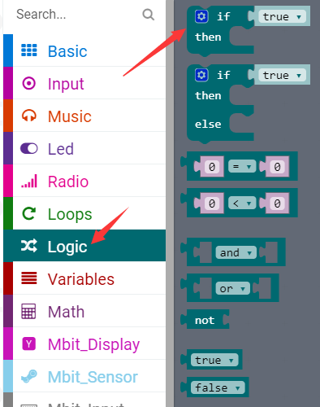
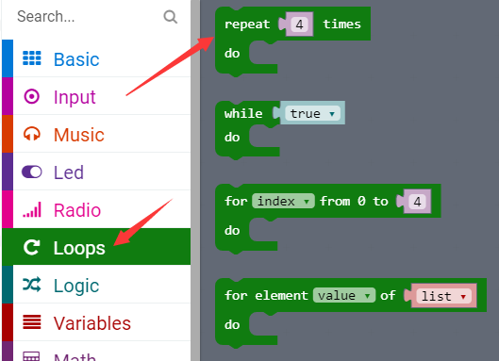
micro:bit entry video tutorial
Part 4
Search for blocks
YahBoom micro:bit creative tutorial

Slide 11
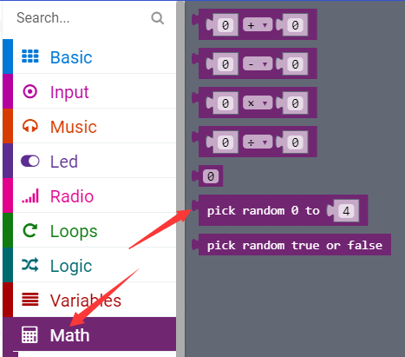
micro:bit entry video tutorial
Part 4
Search for blocks
YahBoom micro:bit creative tutorial

Slide 12
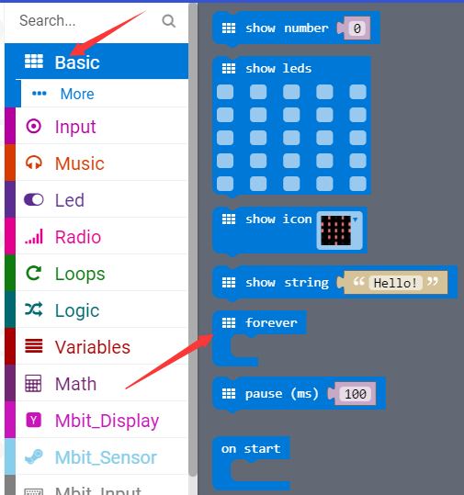
micro:bit entry video tutorial
Part 4
Search for blocks
YahBoom micro:bit creative tutorial

Slide 13
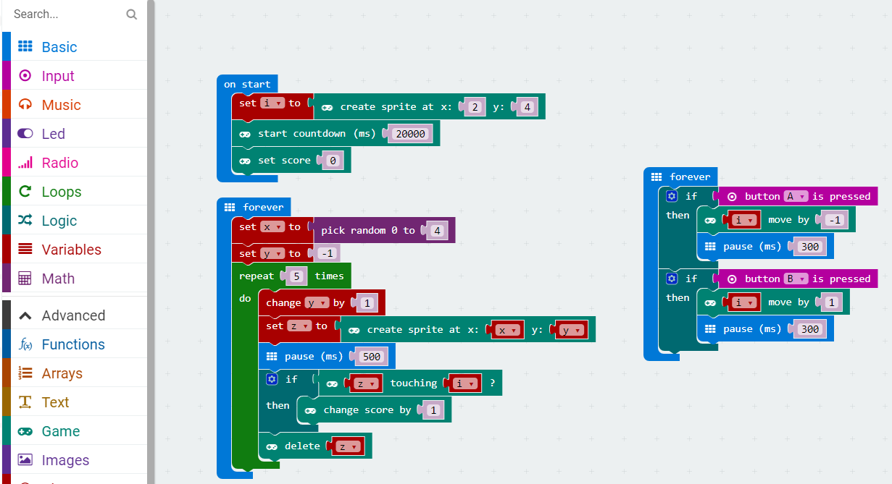
micro:bit entry video tutorial
Part 5
Combine blocks
YahBoom micro:bit creative tutorial

Slide 14
micro:bit entry video tutorial
micro:bit
project
Thanks for watching！
Powered by YahBoom
YahBoom micro:bit module tutorial

